Slide 1
Chapter 0
Computer Languages and Top Structure
Notes:
Greet class

Slide 2
Programming Languages
Computers still rely on human beings to give them directions
  These directions are called programs, and the people who write the programs are called programmers
  Just as human beings communicate with each other through the use of languages such as English, Spanish, Hindi, and Chinese, programmers use a variety of special languages, called programming languages, to communicate with the computer

Slide 3
Categories of programming languages
machine languages
assembly languages
third-generation languages
fourth-generation languages
fifth-generation languages

Slide 4
Machine Languages
Within a computer, data are represented by microscopic electronic switches that can be either off or on
  The off switch is designated by a 0
  The on switch is designated by a 1
Instructions written in 0s and 1s are called machine language or machine code
  Each type of machine has its own language
  Machine languages represent the only way to communicate directly with the computer

Slide 5
Assembly Languages
Slightly more advanced programming languages are called assembly languages
Assembly languages simplify the programmer’s job by allowing the programmer to use mnemonics in place of the 0s and 1s in the program
Mnemonics are memory aids—in this case, alphabetic abbreviations for instructions

Slide 6
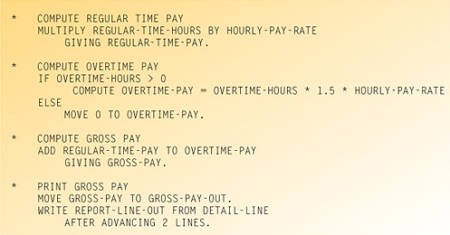
Third-generation language
Uses a series of English-like words to write instructions
Requires program instructions to tell computer what to accomplish and how to do it

Slide 7
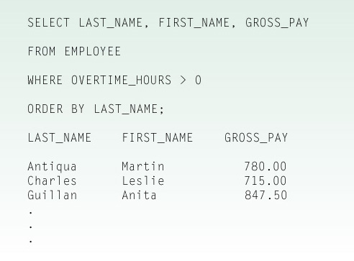
Fourth-generation language
Programmer specifies only what the program should accomplish; it does not explain how

Slide 8
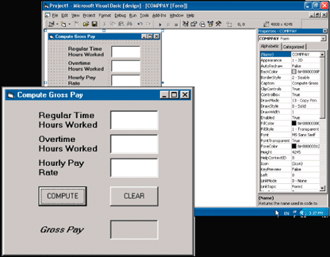
Fifth-generation languages
Provides visual or graphical interface for creating source code
Visual Basic.NET is an example

Slide 9
Applications of Assembly language
1. Development of a programmer: assembly language is the best tool for learning
about computer organization,
about operating systems, data representation, hardware devices, build of functions,
about macros and high-level languages

Slide 10
2. Assembly provides direct communication with the computer’s OS what is needed
If the program has to interact with OS
If the program has to modify the way OS works

Slide 11
3. Hardware access in Assembler is straightforward and easy:
If an Assembly subroutine provides access to a device for all application programs, when it is called as a part of OS then it is called device driver
If an Assembly subroutine provides access to the computer hardware, when called from a program then it is called interface subroutine

Slide 12
4. Assembly language is used to optimize some critical sections of business application programs for speed
A program written in a high-level language calls a subroutine written in Assembly language
Another way of connecting is to include into high-level language program a piece of Assembly code named inline Assembly code (only if the compiler allow such a mixture)

Slide 13
5. Assembler is the best when it comes to higher speed and smaller size
Many devices and processes require real time process (speed) and a small size.
Assembly language provides higher speed, allows smaller size, easy adjustable to the system.
Assembler is used to write embedded systems.

Slide 14
Translating Languages
English: Display the sum of A times B plus C.
C++: cout << (A * B + C);
Assembly Language:
mov eax,A
mul B
add eax,C
call WriteInt
Intel Machine Language:
A1 00000000
F7 25 00000004
03 05 00000008
E8 00500000

Slide 15
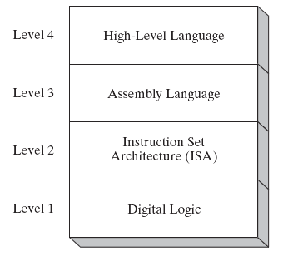
Specific Machine Levels
Machine Language
(descriptions of individual levels follow . . . )

Slide 16
High-Level Language
Level 4
Application-oriented languages
  C++, Java, Pascal, Visual Basic . . .
Programs compile into assembly language (Level 4)

Slide 17
Assembly Language
Level 3
Instruction mnemonics that have a one-to-one correspondence to machine language
Programs are translated into Instruction Set Architecture Level - machine language (Level 2)

Slide 18
Instruction Set Architecture (ISA)
Level 2
Also known as conventional machine language
Executed by Level 1 (Digital Logic)

Slide 19
Digital Logic
Level 1
CPU, constructed from digital logic gates
System bus
Memory
Implemented using bipolar transistors

Slide 20
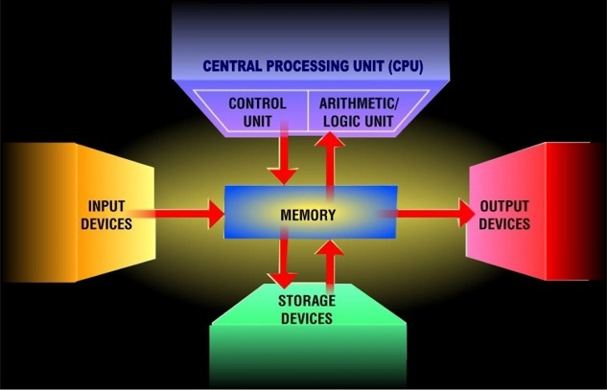

Slide 21
Computer Structure - Top Level
Peripherals
Computer
CPU
Memory
Computer
Systems
Interconnection
Input
Output
Communication
lines

Slide 22
Processor
  ALU (datapath)- performs arithmetic and logic operations
  Control unit – gives directions to the other components

Slide 23
Memory
Memory is a collection of cells (circuits that remember) each with a unique physical address.
A cell consists of bits – an elementary storage unit capable of holding a 1 or 0
But how many bits are in a cell? This number is named addressability – the number of bits stored in each addressable location in memory
Today, most computers are byte (8 bits) addressable.

Slide 24
Other Components
  input - sends data to the computer
  output - gets information from the computer
  storage – stores data, information, programs for the use in the future
  Communication devices

Slide 25
Structure - The CPU
CPU
Computer
Arithmetic
and
Login Unit
I/O
Registers
System
Bus
CPU
Internal CPU
Interconnection
Memory
Control
Unit

Slide 26
Structure - The Control Unit
Control Unit
CPU
ALU
Sequencing
Login
Internal
Bus
Control
Unit
Control Unit
Registers and
Decoders
Registers
Control
Memory

Slide 27
Machine Structures
Application
Linker
Loader Compiler
Assembler
Operating System
BIOS
Software
Instruction Set
Architecture
Hardware
Transistors
Circuits
  Elementary Gates
  Combinational
  Instructions
  state
Datapath (ALU)
Control Unit
Memory
Hardware Interrupt Controller
I/O system

Slide 28
The Instruction Set: a Critical Interface
software
instruction set
hardware

Slide 29
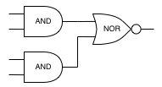
Above and bellow ISA
temp = v[k];
v[k] = v[k+1];
v[k+1] = temp;
High Level Language Program
Mov ax,inp
Add ax, 20
Je Label1
Jmp Label2
Assembly Language Program
0000 1001 1100 0110 1010 1111 0101 1000
1010 1111 0101 1000 0000 1001 1100 0110
1100 0110 1010 1111 0101 1000 0000 1001
0101 1000 0000 1001 1100 0110 1010 1111
Machine Language Program
Hardware Architecture Description
Registers
Logic Circuit Description
ALU

Slide 30
Machine Organization & Architecture
Machine Organization is the view of the computer that is seen by the logic designer. This includes:
  Capabilities & performance characteristics of components
  Ways in which they are interconnected
  How information flows?
  Means by which information flow is controlled
  Coordination of components
Machine Architecture is the view of the computer that is seen from outside. It is the view of the user of the computer system
Notes:
Design state of art organization in 1990

Slide 31
Levels of abstraction
Each level of abstraction consists of
  interface (outside view of what computer does)
  implementation (inside view of how it does that)
Multiplexer
Implementation
A
A
Y
NAND
B
2 x 1 Mux
Y
NAND
B
NAND
Multiplexer
Interface
S
S

Slide 32
What is an Instruction Set?
The complete collection of instructions that are understood by a CPU
Machine Code
Binary
Usually represented by assembly codes
Notes:
2

Slide 33
Instruction Representation
In machine code each instruction has a unique bit pattern
For human consumption (well, programmers anyway) a symbolic representation is used
  e.g. ADD, SUB, LOAD
Operands can also be represented in this way
  ADD A,B
Notes:
5

Slide 34
Elements of an Instruction
Operation code (Op code)
  Do this
Source Operand reference
  To this
Result Operand reference
  Put the answer here
Next Instruction Reference
  When you have done that, do this...
Instruction
Opcode
Operand/s
Notes:
3

Slide 35
Types of Operand
Addresses
Numbers
  Integer/floating point
Characters
  ASCII etc.
Logical Data
  Bits or flags
Notes:
14

Slide 36
Instruction Types
Data processing
Data storage (main memory)
Data movement (I/O)
Program flow control
Notes:
6

Slide 37
Instruction Set Architecture (ISA)
Instruction Set Architecture is a contract between software and hardware. As long as they both follow the contract:
  Software designers can write programs using different programming languages and build software architectures they prefer.
  At the same time hardware designers are free to use the latest technologies, say, moving light inside chips instead of electrons.
  As long as they stick to the ISA contract the computer system will work.

